Slide 1
Matrix
Session 03-06
Course : MATH6030001 - Linear Algebra
Effective Period : February 2024

Slide 2
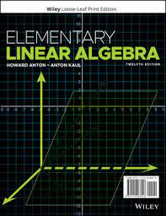
Acknowledgement
These slides have been adapted from:
Howard Anton and Anton Kaul. Elementary linear algebra: Applications version (12th Edition). John Wiley & Sons, 2019.
Section 1.3-1.7, Chapter 2

Slide 3

LO 2: Evaluate determinant and inverse of matrix and their applications.
Learning Objectives

Slide 4
Contents
1
1
Matrices and Matrix Operations
2
2
Algebraic Properties of Matrix
3
3
4 Inverse Matrix
Some Special Matrices
4
5
5 Determinannt of Matrix

Slide 5
Matrices and Matrix Operations

Slide 6
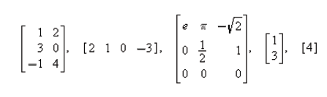
Basic Terminologies (1/4)
Definition
A matrix is a rectangular array of numbers. The numbers in the array are called the entries in the matrix.
Examples
Some examples of matrices are
The size of a matrix is described in terms of the number of rows (horizontal lines) and columns (vertical lines) it contains. For example, the first matrix in above example has three rows and two columns, so its size is 3 by 2 (written 3x2).

Slide 7
Basic Terminologies (2/4)
In a size description, the first number always denotes the number of rows, and the second denotes the number of columns. The remaining matrices in above example have sizes 1x4, 3x3, 2x1, and 1x1, respectively.
A matrix with only one column is called a column vector or a column matrix, and a matrix with only one row is called a row vector or a row matrix. In previous example, the 2x1 matrix is a column vector, the 1x4 matrix is a row vector, and the 1x1 matrix is both a row vector and a column vector.
When discussing matrices, it is common to refer to numerical quantities as scalars. Unless stated otherwise, scalars will be real numbers.

Slide 8


Basic Terminologies (3/4)
The entry that occurs in row i and column j of a matrix A will be denoted by a_{ij}. Thus a general m x n matrix as :
When a compact notation is desired, the preceding matrix can be written as :
the first notation being used when it is important in the discussion to know the size, and the second being used when the size need not be emphasized.
Usually, we will match the letter denoting a matrix with the letter denoting its entries. The entry in row i and column j of a matrix A is also commonly denoted by the symbol (A)_{ij} or a_{ij}.

Slide 9

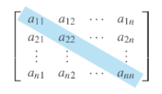
Basic Terminologies (4/4)
As an example, in the matrix
we have (A)₁₁ = 2, (A)₁₂ = -3, (A)₂₁ = 7 and (A)₂₂ = 0.
A matrix A with n rows and n columns is called a square matrix of order n, and the shaded entries a₁₁, a₂₂, ..., a_{nn} in the matrix below are said to be on the main diagonal of A.

Slide 10

Equality of Matrices
Definition
Two matrices are defined to be equal if they have the same size and their corresponding entries are equal.
The equality of two matrices
A=[a_{ij}] and B=[b_{ij}]
of the same size can be expressed by writing a_{ij}=b_{ij}, for all values of i and j in those matrices.
Example
Consider the matrices
If x=5 then A=B, but for all other values of x the matrices A and B are not equal, since not all of their corresponding entries are equal. There is no value of x for which A=C since A and C have different sizes.

Slide 11
Matrix Addition and Substraction
Definition
If A and B are matrices of the same size, then the sum A+B is the matrix obtained by adding the entries of B to the corresponding entries of A, and the difference A-B is the matrix obtained by subtracting the entries of B from the corresponding entries of A. Matrices of different sizes cannot be added or subtracted.
In matrix notation, if A=[a_{ij}] and B=[b_{ij}] have the same size, then
(A+B)_{ij} = (A)_{ij}+(B)_{ij} = a_{ij}+b_{ij}
and
(A-B)_{ij} = (A)_{ij}-(B)_{ij} = a_{ij}-b_{ij}

Slide 12
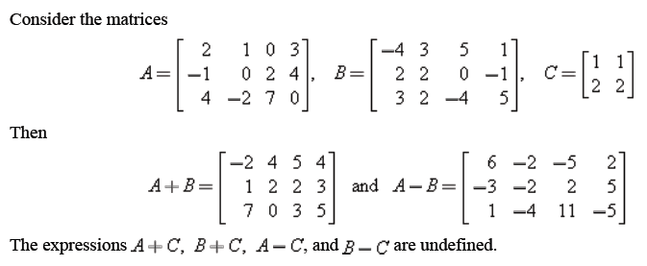
Example

Slide 13
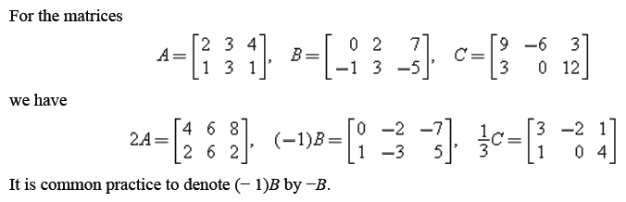
Scalar Multiplication
Definition
If A is any matrix and c is any scalar, then the product c.A is the matrix obtained by multiplying each entry of the matrix A by c. The matrix c.A is said to be a scalar multiple of A.
In matrix notation, if A=[a_{ij}], then
(c.A)_{ij} = c.(A)_{ij} = c.a_{ij}
Example

Slide 14
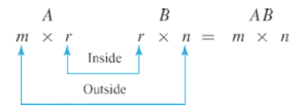
Matrix Multiplication
Definition
If A is m x r an matrix and B is an r x n matrix, then the product AB is the m x n matrix whose entries are determined as follows: To find the entry in row i and column j of AB, single out row i from the matrix A and column j from the matrix B. Multiply the corresponding entries from the row and column together, and then add up the resulting products.

Slide 15
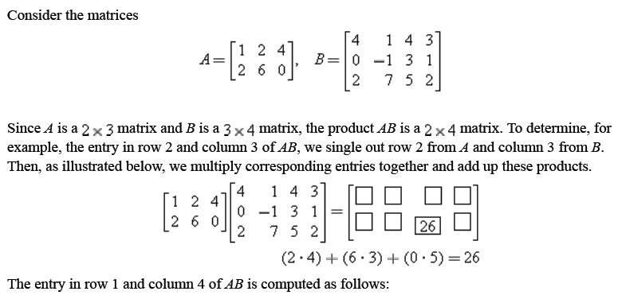
Example

Slide 16
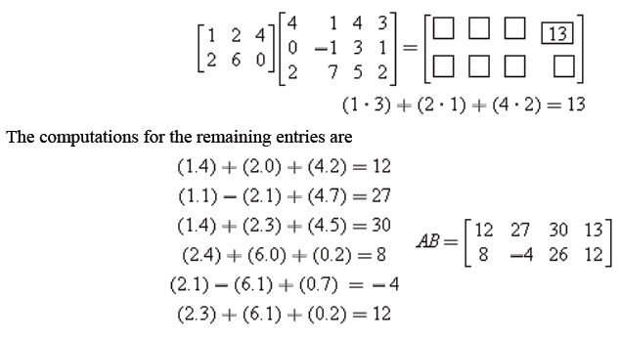
Example (Cont.)

Slide 17
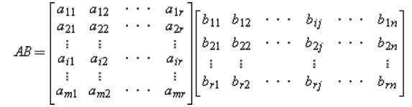

General Formula of Matrix Multiplication
If A=[a_{ij}] is an m x r matrix and B=[b_{ij}] is an r x n matrix, then :
the entry (AB)ij in row i and column j of AB is given by
Notes : Suppose that A, B, and C are 3x4, 4x7 and 7x3 matrices, respectively. Then, AB is defined and is a 3x7 matrix; BC is defined and is a 4x3 matrix; and CA is defined and is a 7x4 matrix. The products AC, CB, and BA are all undefined.

Slide 18
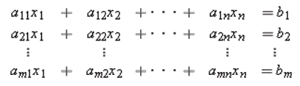
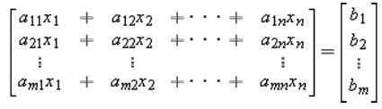
Matrix Form of a Linear System
Matrix multiplication has an important application to systems of linear equations. Consider a system of m linear equations in n unknowns:
Since two matrices are equal if and only if their corresponding entries are equal, we can replace the m equations in this system by the single matrix equation

Slide 19
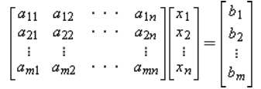
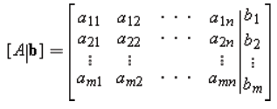
Matrix Form of a
Linear System (Cont.)
The m x 1 matrix on the left side of this equation can be written as a product to give
If we designate these matrices by A, x, and b, respectively, then we can replace the original system of m equations in n unknowns has been replaced by the single matrix equation
A.x=b
The matrix A in this equation is called the coefficient matrix of the system. The augmented matrix for the system is obtained by adjoining b to A as the last column; thus the augmented matrix is

Slide 20
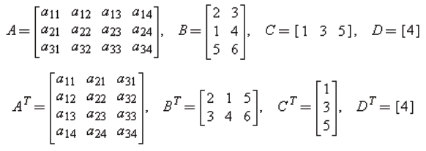
Transpose of a Matrix
Definition
If A is any m x n matrix, then the transpose of A, denoted by A^{T}, is defined to be the n x m matrix that results by interchanging the rows and columns of A; that is, the first column of A^{T} is the first row of A, the second column of A^{T} is the second row of A, and so forth.
Example
The following are some examples of matrices and their transposes.

Slide 21
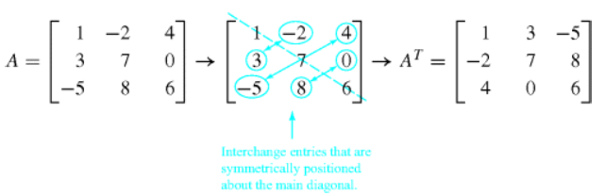
Transpose of a Matrix (Cont.)
Observe that not only are the columns of A^{T} the rows of A, but the rows of A^{T} are the columns of A. Thus the entry in row i and column j of A^{T} is the entry in row j and column i of A; that is,
(A^{T})_{ij} = (A)_{ji}
In the special case where A is a square matrix, the transpose of A can be obtained by interchanging entries that are symmetrically positioned about the main diagonal. We see that A^{T} can also be obtained by “reflecting” A about its main diagonal.

Slide 22
Properties of the Transpose
Theorem
If the sizes of the matrices are such that the stated operations can be performed, then:
(A^{T})^{T} = A
(A + B)^{T} = A^{T} + B^{T}
(A - B)^{T} = A^{T} - B^{T}
(k.A)^{T} = k.A^{T}
(A.B)T = B^{T}.A^{T} (The transpose of a product of any number of matrices is the product of the transposes in the reverse order)

Slide 23
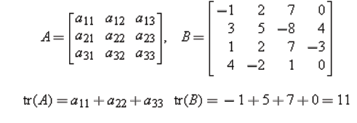
Trace of a Matrix
Definition
If A is a square matrix, then the trace of A, denoted by tr(A), is defined to be the sum of the entries on the main diagonal of A. The trace of A is undefined if A is not a square matrix.
Example
The following are examples of matrices and their traces.

Slide 24
Algebraic Properties of Matrix

Slide 25
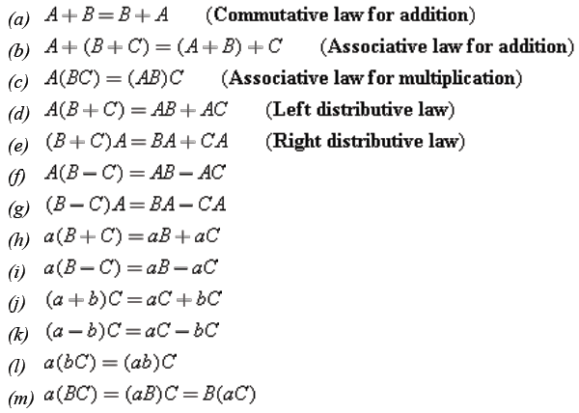
Properties of Matrix Arithmetic
Theorem
Assuming that the sizes of the matrices are such that the indicated operations can be performed, the following rules of matrix arithmetic are valid.

Slide 26

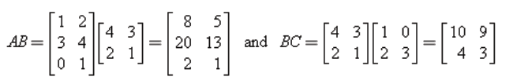
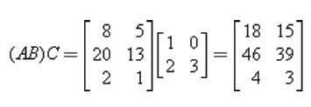
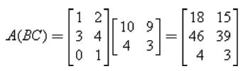
Associativity of Matrix Multiplication
As an illustration of the associative law for matrix multiplication, consider
Then
Thus
and
So (AB)C=A(BC), as it is stated in the theorem part (c).

Slide 27


Matrix Multiplication is not Commutative
Do not think that all laws of real arithmetic carry over to matrix arithmetic. For example, you know that in real arithmetic it is always true that a.b=b.a, which is called the commutative law for multiplication. In matrix arithmetic, however, the equality of AB and BA can fail for three possible reasons :
AB may be defined and BA may not (for example, if A is 2x3 and B is 3x4).
AB and BA may both be defined, but they may have different sizes (for example, if A is 2x3 and B is 3x2).
AB and BA may both be defined and have the same size, but the two matrices may be different (as illustrated in the next example).
Example
Consider the matrices
Multiplying gives
Thus, AB≠BA.

Slide 28
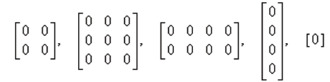
Zero Matrices
Definition
A matrix whose entries are all zero is called a zero matrix. Some examples are
We will denote a zero matrix by 0 unless it is important to specify its size, in which case we will denote the m x n zero matrix by 0_{mxn}.
It should be evident that if A and 0 are matrices with the same size, then A+0 = 0+A = A.
Thus, 0 plays the same role in this matrix equation that the number 0 plays in the numerical equation a+0 = 0+a = a.

Slide 29
Properties of Zero Matrices
Theorem
If c is a scalar, and if the sizes of the matrices are such that the operations can be performed, then:
A + 0 = 0 + A = A
A – 0 = A
A – A = A + (-A) = 0
0.A = 0
If c.A = 0, then c=0 or A=0
Notes : In real arithmetic, we know that :
If a.b = a.c and a ≠ 0, then b = c. (The cancellation law)
If a.b = 0, then at least one of the factors on he left is 0.
However, those laws are not universally true in matrix arithmetic.

Slide 30



Other Laws which Doesn’t Hold in Matrix Multiplication
Example 1
Consider the matrices
We can compute that
Although A≠0, canceling A from both sides of the equation AB=AC would lead to the incorrect conclusion that B = C. Thus, the cancellation law does not hold, in general, for matrix multiplication.
Example 2
Here are two matrices for which A.B = 0, but A ≠ 0 and B ≠ 0.

Slide 31
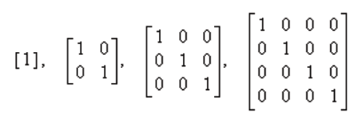
Identity Matrices
Definition
A square matrix with 1's on the main diagonal and zeros elsewhere is called an identity matrix. Some examples are
An identity matrix is denoted by the letter I. If it is important to emphasize the size, we will write I_{n} for the n x n identity matrix.
The identity matrices play the same role in these matrix equations that the number 1 plays in the numerical equation : a.1 = 1.a = a, as explained in the next slide.

Slide 32


Properties of Identity Matrices
To explain the role of identity matrices in matrix arithmetic, let us consider the effect of multiplying a general 2x3 matrix A on each side by an identity matrix. Multiplying on the right by the 3x3 identity matrix yields
and multiplying on the left by the 2x2 identity matrix yields
The same result holds in general; that is, if A is m x n any matrix, then :
A.I_{n} = A and I_{m}.A = A.

Slide 33
Some Special Matrices

Slide 34
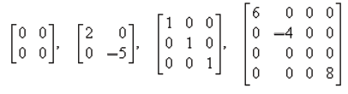
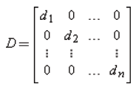
Diagonal Matrices
Definition
A square matrix in which all the entries off the main diagonal are zero is called a diagonal matrix. Here are some examples:
A general n x n diagonal matrix D can be written as

Slide 35
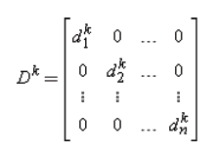

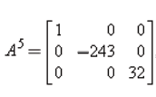
Properties of Diagonal Matrices
If D is the diagonal matrix 1 and k is a positive integer, then
Example
If , then .
Note : Power of a square matrix A to the n, denoted by A^{n}, is defined as : A^{n} = A.A.....A [n factors]. We will discuss more about power of matrix in next topic.

Slide 36
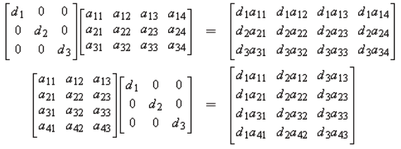
Properties of Diagonal Matrices
Matrix products that involve diagonal factors are especially easy to compute. For example,
In words, to multiply a matrix A on the left by a diagonal matrix D, one can multiply successive rows of A by the successive diagonal entries of D, and to multiply A on the right by D, one can multiply successive columns of A by the successive diagonal entries of D.

Slide 37
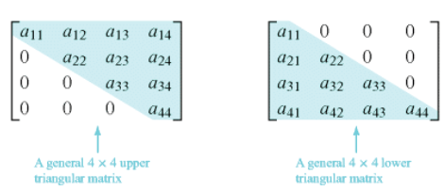
Triangular Matrices
Definition
A square matrix in which all the entries above the main diagonal are zero is called lower triangular, and a square matrix in which all the entries below the main diagonal are zero is called upper triangular. A matrix that is either upper triangular or lower triangular is called triangular.

Slide 38

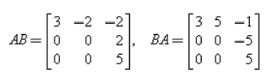
Properties of Triangular Matrices
Theorem
The transpose of a lower triangular matrix is upper triangular, and the transpose of an upper triangular matrix is lower triangular.
The product of lower triangular matrices is lower triangular, and the product of upper triangular matrices is upper triangular.
Example
Consider the upper triangular matrices :
We can compute that both AB and BA are also upper triangular :

Slide 39
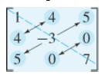
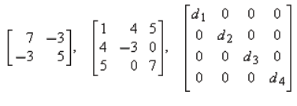
Symmetric Matrices
Definition
A square matrix A is said to be symmetric if A = A^{T}.
It is easy to recognize a symmetric matrix by inspection: The entries on the main diagonal have no restrictions, but mirror images of entries across the main diagonal must be equal, as in this illustration :
Example :
The following matrices are symmetric, since each is equal to its own transpose :

Slide 40
Properties of Symmetric Matrices
A square matrix A=[a_{ij}] is symmetric if and only if (A)_{ij} = (A)_{ji}, for all values of i and j. That is, A^{T}= A.
Theorem
If A and B are symmetric matrices with the same size, and if k is any scalar, then:
A^{T} is symmetric.
A + B and A – B are symmetric.
k.A is symmetric.
A.B is symmetric if and only if A.B = B.A.
(The product of two symmetric matrices is symmetric if and only if the matrices commute)

Slide 41
Inverse MATRIX AND ITS PROPERTIES

Slide 42
Inverse
Definition
If 𝐴 is a square matrix, and if there exists a matrix 𝐵 of the same size for which 𝐴𝐵 = 𝐵𝐴 = 𝐼, then 𝐴 is said to be invertible (or nonsingular) and 𝐵 is called an inverse of 𝐴. If no such matrix 𝐵 exists, then 𝐴 is said to be singular.

Slide 43
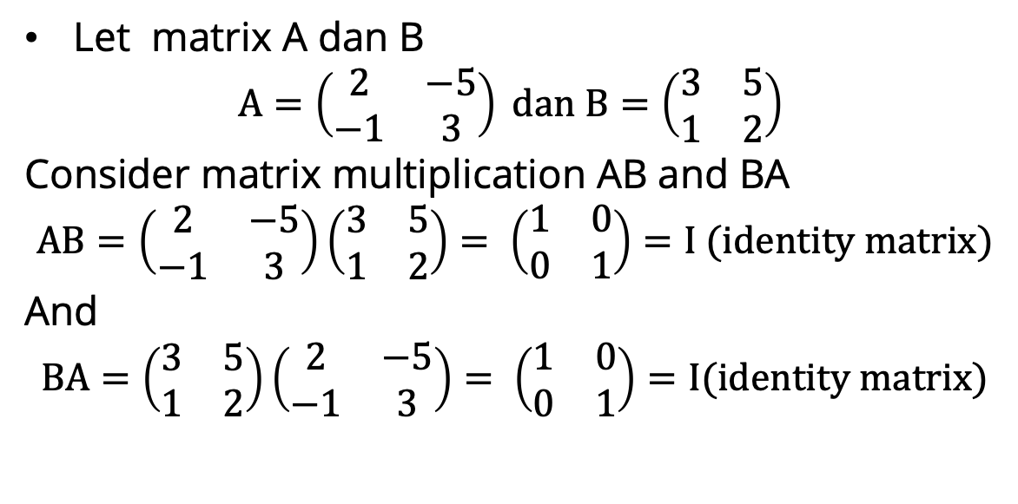
Example
Let matrix A dan B
$$A=\left(\begin{matrix}2 & −5 \\ −1 & 3\end{matrix}\right) dan B=\left(\begin{matrix}3 & 5 \\ 1 & 2\end{matrix}\right)$$
Consider matrix multiplication AB and BA
$$AB=\left(\begin{matrix}2 & −5 \\ −1 & 3\end{matrix}\right)\left(\begin{matrix}3 & 5 \\ 1 & 2\end{matrix}\right)= \left(\begin{matrix}1 & 0 \\ 0 & 1\end{matrix}\right)=I (identity matrix)$$
And
$$BA=\left(\begin{matrix}3 & 5 \\ 1 & 2\end{matrix}\right)\left(\begin{matrix}2 & −5 \\ −1 & 3\end{matrix}\right)= \left(\begin{matrix}1 & 0 \\ 0 & 1\end{matrix}\right)=I(identity matrix)$$

Slide 44
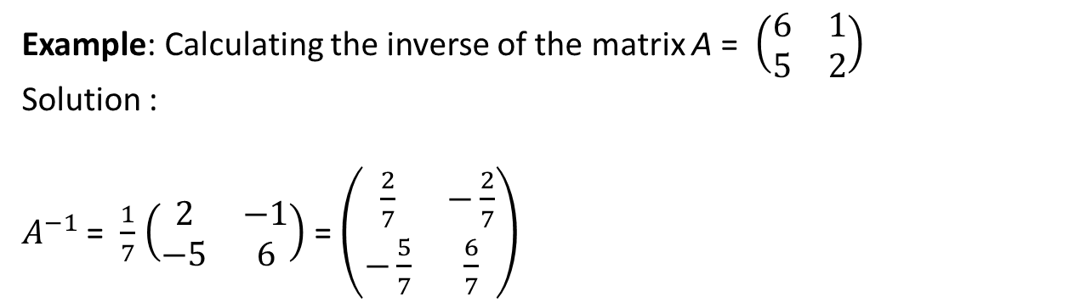
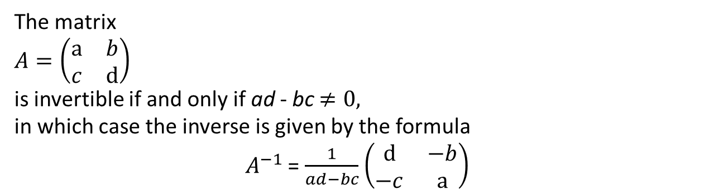
Inverse
Inverse of 2 × 2 Matrix
Theorem
The matrix
$A=\left(\begin{matrix}a & b \\ c & d\end{matrix}\right)$
is invertible if and only if ad - bc $≠0,$
in which case the inverse is given by the formula
$A^{−1}$ = $\frac{1}{ad−bc}$ $\left(\begin{matrix}d & −b \\ −c & a\end{matrix}\right)$
Example: Calculating the inverse of the matrix A = $\left(\begin{matrix}6 & 1 \\ 5 & 2\end{matrix}\right)$
Solution :
$A^{−1}$ = $\frac{1}{7}$ $\left(\begin{matrix}2 & −1 \\ −5 & 6\end{matrix}\right)$ = $\left(\begin{matrix}\frac{2}{7} & −\frac{2}{7} \\ −\frac{5}{7} & \frac{6}{7}\end{matrix}\right)$

Slide 45
Inverse
Theorem
1. If 𝐴 and 𝐵 are invertible matrices with the same size, then 𝐴𝐵 is invertible and
${(AB)}^{−1}=B^{−1}$ $A^{−1}$
2. If 𝐴 is invertible and n is a nonnegative integer, then:
(a) 𝐴⁻¹ is invertible and (𝐴⁻¹)⁻¹ = 𝐴.
(b) 𝐴n is invertible and (𝐴^{n})⁻¹ = 𝐴^{−n} = (𝐴⁻¹)^{n}.
(c) k𝐴 is invertible for any nonzero scalar k, and (k𝐴)⁻¹ = k⁻¹𝐴⁻¹.

Slide 46
Inverse Technique : Inversion Algorithm
To find the inverse of an invertible matrix A, find a sequence of elementary row operations that reduces A to the identity and then perform that same sequence of operations on I_{n} to obtain A⁻¹.
To accomplish this we will adjoin the identity matrix to the right side of A, thereby producing a partitioned matrix of the form
[ A | I ]
Then we will apply row operations to this matrix until the left side is reduced to I; these operations will convert the right side to A⁻¹, so the final matrix will have the form
[ I | A⁻¹ ]

Slide 47
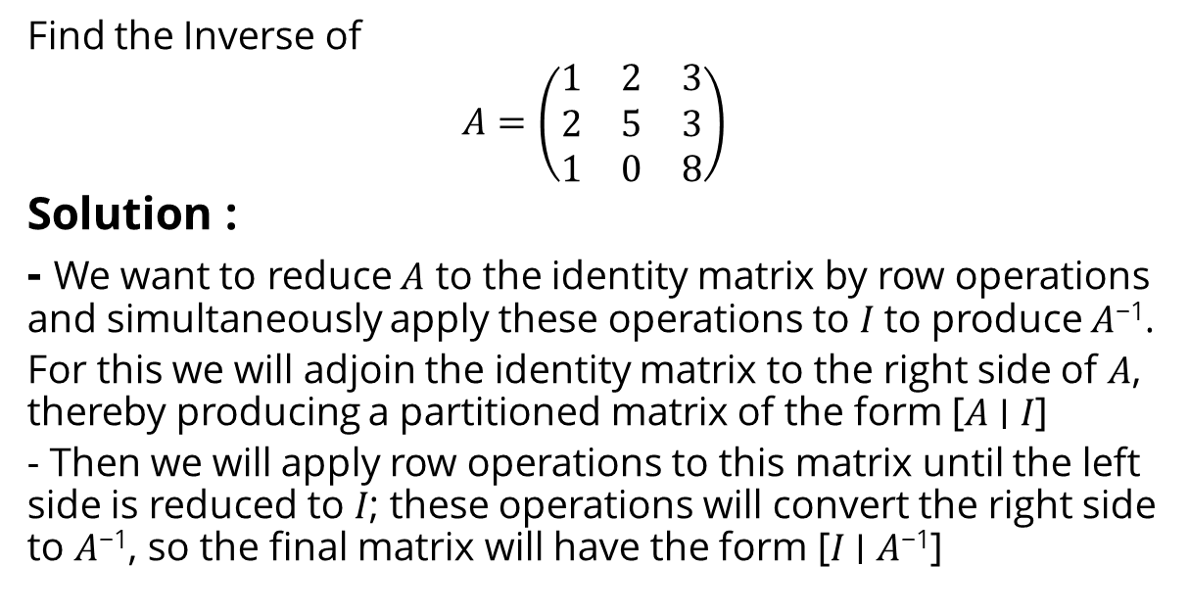
Example: Using Row Operations to Find A⁻¹.
Find the Inverse of
$$A=\left(\begin{matrix}1 & 2 & 3 \\ 2 & 5 & 3 \\ 1 & 0 & 8\end{matrix}\right)$$
Solution :
- We want to reduce 𝐴 to the identity matrix by row operations and simultaneously apply these operations to 𝐼 to produce 𝐴⁻¹.
For this we will adjoin the identity matrix to the right side of 𝐴, thereby producing a partitioned matrix of the form [𝐴 ∣ 𝐼]
- Then we will apply row operations to this matrix until the left side is reduced to 𝐼; these operations will convert the right side to 𝐴⁻¹, so the final matrix will have the form [𝐼 ∣ 𝐴⁻¹]

Slide 48
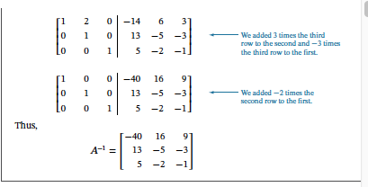
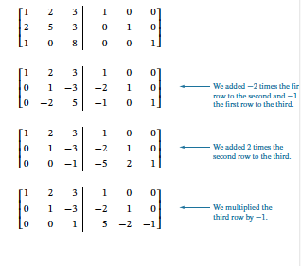
Example
The computations are as follows:

Slide 49
Inverse of a Product
Theorem
If A and B are invertible matrices with the same size, then A.B is invertible and
(A.B)⁻¹ = B⁻¹.A⁻¹
The theorem above can be extended to three or more matrices :
A product of any number of invertible matrices is invertible, and the inverse of the product is the product of the inverses in the reverse order.

Slide 50
More Properties of Inverse Matrix
Here is some properties of inverse matrix related to exponent and transpose.
Theorem
If A is invertible and n is a nonnegative integer, then:
A⁻¹ is invertible and (A⁻¹)⁻¹ = A.
A^{n} is invertible and (A^{n})⁻¹ = A^{-n} = (A⁻¹)^{n}.
k.A is invertible for any nonzero scalar k, and
(k.A)⁻¹ = k⁻¹.A⁻¹.
A^{T} is invertible and (A^{T})⁻¹ = (A⁻¹)^{T}.

Slide 51
Solving Linear Systems by Matrix Inversion
So far we have studied two procedures for solving linear system: Gauss–Jordan elimination and Gaussian elimination. The following theorem provides an actual formula for the solution of a linear system of n equations in n unknowns in the case where the coefficient matrix is invertible.
Theorem
If A is an invertible n x n matrix, then for each n x 1 matrix b, the system of equations A.x = b has exactly one solution, namely
x = A⁻¹.b.
The theorem above can be proved easily by multiplying each both sides by A⁻¹ from the left.

Slide 52


Example
Consider the system of linear equations
In matrix form this system can be written as A.x = b, where

Slide 53


Example (Cont.)
In previous example we showed that A is invertible and
The solution of the system is
or x₁ = 1, x₂ = -1, x₃ =2.

Slide 54
Determinant

Slide 55
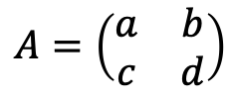

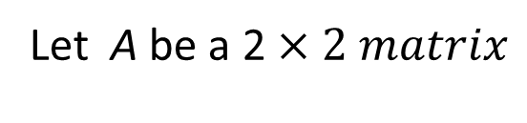

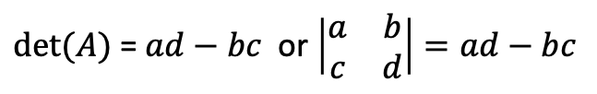
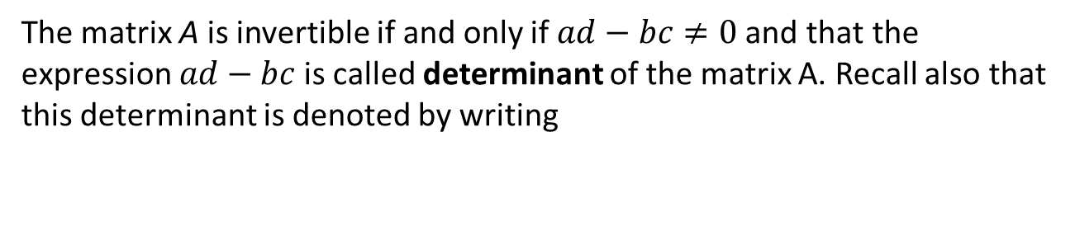
Determinant M$atrix$ 2$×2$
Let A be a 2 $×2 matrix$
$$A=\left(\begin{matrix}a & b \\ c & d\end{matrix}\right)$$
The matrix A is invertible if and only if $ad−bc≠0 \text{and} \text{that} \text{the} \text{expression}$ $ad−bc$ is called determinant of the matrix A. Recall also that this determinant is denoted by writing
$det⁡(A)$ = $ad−bc$ or $\left|\begin{matrix}a & b \\ c & d\end{matrix}\right|=ad−bc$
$Note : det⁡(A)$ is a number, whereas A is a matrix.

Slide 56


Inverse and determinant
Let A be an $n x n matrix$
.
The matrix A is invertible if and only d$et(A)≠0.$

Slide 57
Calculating Determinants and Inverse by Cofactor Ekxpansion

Slide 58
Minor and Cofactor
Definition
If A is a square matrix, then the minor of entry a_{ij} is denoted by M_{ij} and is defined to be the determinant of the submatrix that remains after
the i-th row and j-th column are deleted from A.
The number (-1)^{i+j} M_{ij} is denoted by C_{ij} and is called the cofactor of the entry a_{ij.}

Slide 59
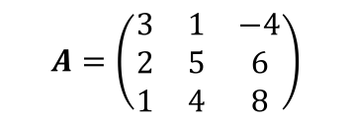
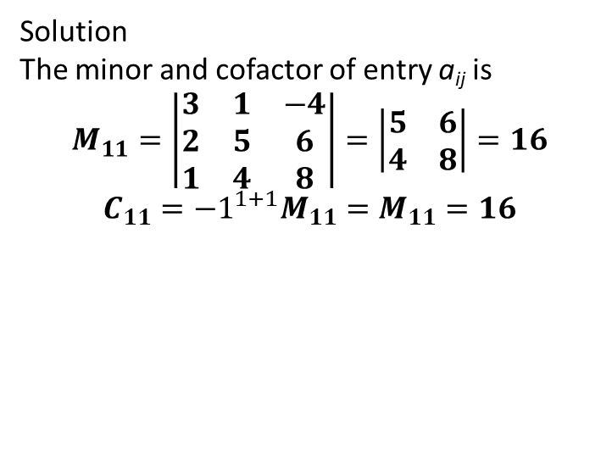
Minor and Cofactor
Definition
If A is a square matrix, then the minor of entry a_{ij} is denoted by M_{ij} and is defined to be the determinant of the submatrix that remains after the i-th row and j-th column are deleted from A. The number (-1)^{i+j} M_{ij} is denoted by C_{ij} and is called the cofactor of entry a_{ij}
Example : Finding Minors and Cofactors
$$A=\left(\begin{matrix}3 & 1 & −4 \\ 2 & 5 & 6 \\ 1 & 4 & 8\end{matrix}\right)$$
Solution
The minor and cofactor of entry a_{ij} is
$$M_{11}=\left|\begin{matrix}3 & 1 & −4 \\ 2 & 5 & 6 \\ 1 & 4 & 8\end{matrix}\right|=\left|\begin{matrix}5 & 6 \\ 4 & 8\end{matrix}\right|=16$$
$$C_{11}={−1}^{1+1}M_{11}=M_{11}=16$$

Slide 60
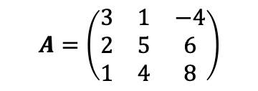
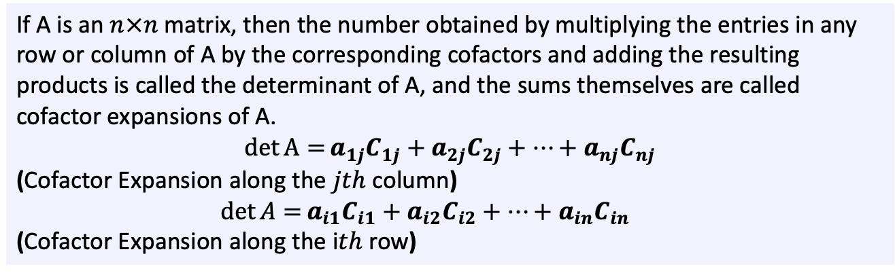
Determinants by Cofactor Expansion
Definition
If A is an $n×n$ matrix, then the number obtained by multiplying the entries in any row or column of A by the corresponding cofactors and adding the resulting products is called the determinant of A, and the sums themselves are called cofactor expansions of A.
$$\det{A=}a_{1j}C_{1j}+a_{2j}C_{2j}+…+a_{nj}C_{nj}$$
(Cofactor Expansion along the $jth$ column)
$\det{A=}a_{i1}C_{i1}+a_{i2}C_{i2}+…+a_{in}C_{in}$
(Cofactor Expansion along the i$th$ row)
Example : Find the determinant of the matrix by cofactor expansion along the first row.
$$A=\left(\begin{matrix}3 & 1 & −4 \\ 2 & 5 & 6 \\ 1 & 4 & 8\end{matrix}\right)$$

Slide 61
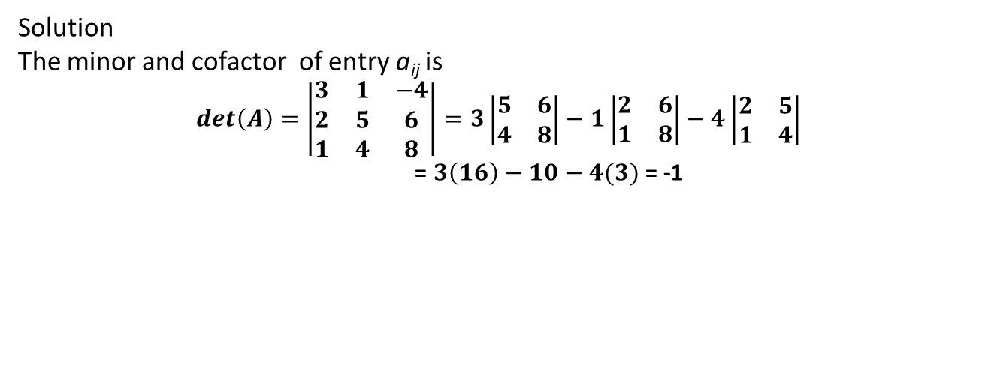
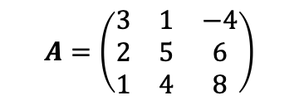
Determinants by Cofactor Expansion
Example : Find the determinant of the matrix by cofactor expansion along the first row.
$$A=\left(\begin{matrix}3 & 1 & −4 \\ 2 & 5 & 6 \\ 1 & 4 & 8\end{matrix}\right)$$
Solution
The minor and cofactor of entry a_{ij} is
$$det\left(A\right)=\left|\begin{matrix}3 & 1 & −4 \\ 2 & 5 & 6 \\ 1 & 4 & 8\end{matrix}\right|=3\left|\begin{matrix}5 & 6 \\ 4 & 8\end{matrix}\right|−1\left|\begin{matrix}2 & 6 \\ 1 & 8\end{matrix}\right|−4\left|\begin{matrix}2 & 5 \\ 1 & 4\end{matrix}\right|$$
= $3\left(16\right)−10−4(3)$ = -1

Slide 62
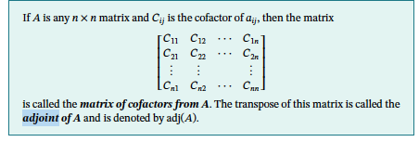
2. Inverse of a Matrix Using Its Adjoint
Definition : Adjoint

Slide 63
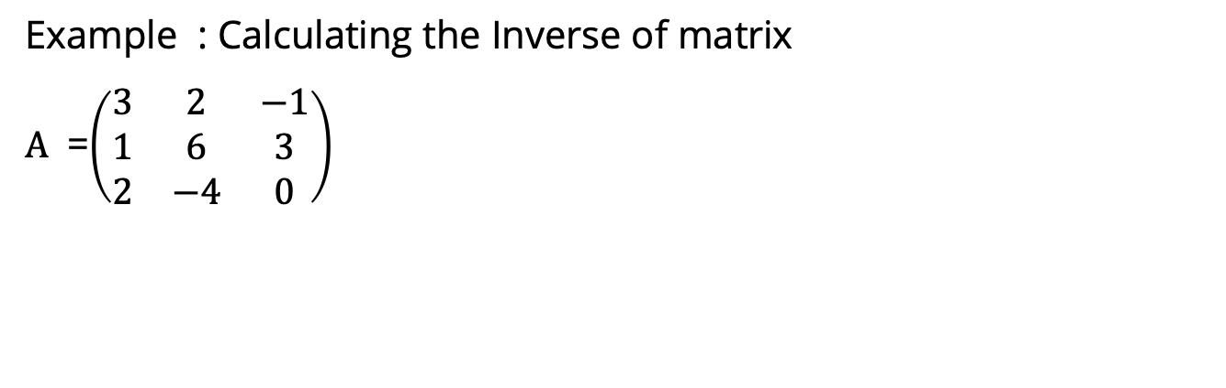
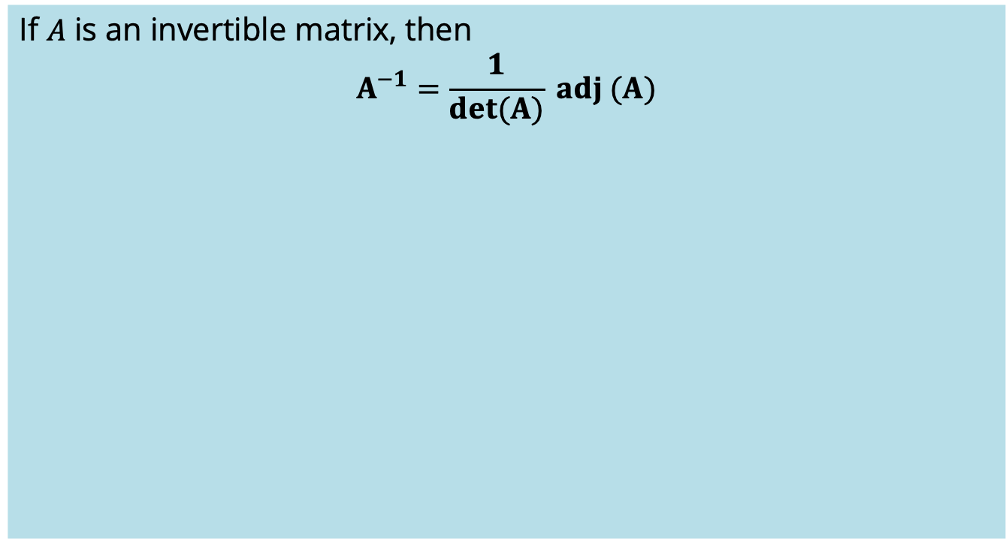
Inverse of a Matrix Using Its Adjoint
If 𝐴 is an invertible matrix, then
$$A^{−1}=\frac{1}{det(A)} adj (A)$$
Example : Calculating the Inverse of matrix
$A$ =$\left(\begin{matrix}3 & 2 & −1 \\ 1 & 6 & 3 \\ 2 & −4 & 0\end{matrix}\right)$

Slide 64

Inverse of a Matrix Using Its Adjoint
Solution :
Find the Determinant of A
$\left|\begin{matrix}3 & 2 & −1 \\ 1 & 6 & 3 \\ 2 & −4 & 0\end{matrix}\right|$ = 64
b. Find the adjoin of matrix A
$Adj (A)=\left(\begin{matrix}12 & 4 & 12 \\ 6 & 2 & −10 \\ −16 & 16 & 16\end{matrix}\right)$
$A^{−1}=\frac{1}{det(A)} adj (A)$
$A^{−1}=$ $\frac{1}{64}\left(\begin{matrix}12 & 4 & 12 \\ 6 & 2 & −10 \\ −16 & 16 & 16\end{matrix}\right)=\left(\begin{matrix}\frac{12}{64} & \frac{4}{64} & \frac{12}{64} \\ \frac{6}{64} & \frac{2}{64} & −\frac{10}{64} \\ −\frac{16}{64} & \frac{16}{64} & \frac{16}{64}\end{matrix}\right)$

Slide 65
Properties of determinant

Slide 66
Properties of Determinants
Theorem
Let A be a square matrix.
If A has a row of zeros or a column of zeros, then det(A)=0.
det(A) = det(A^{T}).

Slide 67
Properties of Determinants
Theorem
Suppose that A and B are n x n matrices and k is any scalar. We have the following properties :
det(A.B) = det(A).det(B)
det(k.A) = k^{n}.det(A)
In general, det(A+B) ≠ det(A)+det(B)

Slide 68

Determinants of
Triangular Matrices
Theorem
If A is an n x n triangular matrix (upper triangular, lower triangular, or diagonal),
then det(A) is the product of the entries on the main diagonal of the matrix; that is, det(A) = a₁₁.a₂₂.....a_{nn}.

Slide 69
Calculating Determinants by Row Reduction

Slide 70

Theorem
Let A be an $n×n$ matrix.
(a) If B is the matrix that results when a single row or single column of A is multiplied by a scalar $k$, then $\det\left(B\right)$ = $k \det\left(A\right)$
(b) If B is the matrix that results when two rows or two columns of A are interchanged,
then $\det\left(B\right)$ = -$\det\left(A\right)$.
(c) If B is the matrix that results when a multiple of one row of A is added to another row or when a multiple of one column is added to another column, then $\det\left(B\right)$ = $\det\left(A\right)$.

Slide 71


Slide 72


Example
Find the determinant of$\left(\begin{matrix}0 & 1 & 5 \\ 3 & −6 & 9 \\ 2 & 6 & 1\end{matrix}\right)$
Solution

Slide 73
The Cramer’s Rule

Slide 74

Cramer’s Rule
Our next theorem uses the formula for the inverse of an invertible matrix to produce a formula, called Cramer's rule, for the solution of a linear system A.x = b of n equations in n unknowns in the case where the coefficient matrix A is invertible (or, equivalently, when det(A) ≠ 0).

Slide 75


Cramer’s Rule
Theorem (Cramer’s Rule)
If A.x=b is a system of n linear equations in n unknowns such that det(A) ≠ 0, then the system has a unique solution. This solution is
where A_{j} is the matrix obtained by replacing the entries in the j-th column of A by the entries in the matrix

Slide 76


Example

Slide 77

Example
Note : For n > 3, it is usually more efficient to solve a linear system with n equations in n unknowns by Gauss–Jordan elimination than by Cramer's rule. Its main use is for obtaining properties of solutions of a linear system without actually solving the system.

Slide 78
References
    Howard Anton and Anton Kaul. (2019). Elementary Linear Algebra. 12. Wiley. New Jersey. ISBN: 978-1-119-40677-8

Slide 79

Thank You

